Slide 1
Effets de réseau et financement participatif : une analyse empirique
Paul Belleflamme, Thomas Lambert, and Armin Schwienbacher

Slide 2
Network effects are central for digital platforms…
... but little systematic evidence on their incidence
Our aim: Contribute to fill this gap
  Laboratory
    A crowdfunding platform (CFP)
  Theoretical contribution
    We systematically map potential network effects at work on CFPs
    We draw an important distinction between participation and usage
  Empirical contribution
    We identify the prevalence of various network effects
    We assess their relative intensity

Slide 3



Platform = ‘manager of network effects’
+ / - / none ?
+ / - / none ?
+ / - / none ?
+ / - / none ?

Slide 4

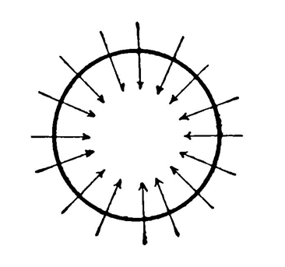
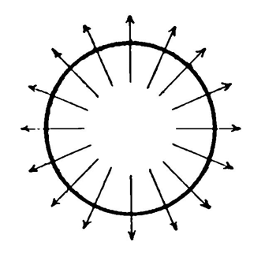
Why care?
Implications for CFP management
  Success of a CFP depends not only on the quality and quantity of projects but also on their mix
    Platforms should identify the projects they need to feature together
  Recurrent users behave quite differently from new users
    Platforms should aim different strategies at these two types of users
Implications for CFP competition
Forces leading to
concentration
Positive cross-group effects
Positive within-group effects
Scale economies
Forces leading to
coexistence of platforms
Negative cross-group effects
Negative within-group effects
Platform differentiation
(model, geography, sector)

Slide 5

Network effects in crowdfunding
(+) Higher chances to have project funded
(+) Better market testing
(+) Improved efficiency
(+) Collective attention
Entrepreneurs
CFP
Backers
(-) More competition
(+) Exchange of good practices
(+) Better services from the platform or from third-parties
(+) Higher chances to get compensated
(+) Word-of-mouth
(-) More competition for rewards or equity
(+) Wider set of projects to choose from
(+) Better fit of rewards
(-) Lower chances that any given campaign will be successful

Slide 6
Predictions
Hypothesis 1 – Intra-project network effects
Backers’ contributions to a particular project increase future contributions to that project
Hypothesis 2 – Inter-project network effects
Backers’ contributions to other projects increase future contributions to a given project

Slide 7
Data
ULULE: Reward-based CFP
    Why a reward-based CFP and not an equity-based CFP?
      Larger number of campaigns running simultaneously
    Why a (smaller) French CFP and not a (larger) U.S. CFP?
      Deficit in size and notoriety compensated by richness of database
  What we observe
    23,971 campaigns posted on the platform from 05/07/2010 (opening day) to 29/11/2016, in 15 categories
    All 1.3 million of contributions to these campaigns + when (date/time), how much and by whom
  What we can track
    Funding dynamics (within and across projects)
    Backers’ behavior

Slide 8
Intra- and inter-project network effects: Magnitudes
  Evidence of positive intra- and inter-project network effects
    Economically, a 10% increase in # contributions to project i yesterday leads to a:
      1.72% increase in # contributions to project i today
      0.11% increase in # contributions to project j today (if j belongs to the same category as i)
      0.42% increase in # contributions to project j today (if j belongs to a different category than i)
Impacts of control variables
    Number of active projects ⇨ Negative
      Enhanced competition for pledges among entrepreneurs
      Indication of negative within-group network effect for entrepreneurs
    Proximity to funding goal ⇨ Positive
      Goal-gradient effect: #contributions higher close to funding goal
    ‘Popularity’ ⇨ Positive
      Projects featured on Ulule’ s first page generate more contributions.
    Share of recurrent backers ⇨ Positive
      Recurrent backers seem to generate larger within-group network effects

Slide 9

Intra- and inter-project network effects: Further tests
Further estimations
  Categories
    Some categories generate relatively more inter-project network effects than other categories
    E.g., ‘music’ or ‘art & photos’ > Average > ‘games’
  New vs. recurrent backers
    Coefficient estimates of intra- and inter-project network effects are higher for new than for recurrent backers
    Consistent with the idea that new backers are less sophisticated than recurrent backers
Robustness
  Similar results when considering instead:
      Volume of contributions (€-amount)
      ‘Single-diff’ identification using fast starters
      Data from another platform (KissKissBankBank)

Slide 10
Takeaways
Evidence of a variety of network effects on CFPs
    Dynamic effects within the group of backers related to usage
      Positive intra- and inter-project network effects
    Positive inter-project network effects indicate a positive-sum game among entrepreneurs
      Platform growth
      Positive network effects related to participation
    Marked differences
      Across categories of projects
      Between recurrent and new backers
  More on this in our working paper updated on ssrn:
  https://papers.ssrn.com/sol3/papers.cfm?abstract_id=3259191

Slide 11

Thank You

