Slide 1
Effets de réseau et financement participatif : une analyse empirique
Paul Belleflamme, Thomas Lambert, and Armin Schwienbacher

Slide 2
Network effects are central for digital platforms…
... but little systematic evidence on their incidence
Our aim: Contribute to fill this gap
Laboratory
A crowdfunding platform (CFP)
Theoretical contribution
We systematically map potential network effects at work on CFPs
We draw an important distinction between participation and usage
Empirical contribution
We identify the prevalence of various network effects
We assess their relative intensity

Slide 3
Platform = ‘manager of network effects’
+ / - / none ?
+ / - / none ?
+ / - / none ?
+ / - / none ?

Slide 4
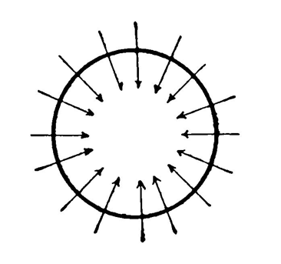
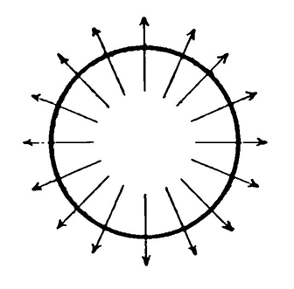
Why care?
Implications for CFP management
Success of a CFP depends not only on the quality and quantity of projects but also on their mix
Platforms should identify the projects they need to feature together
Recurrent users behave quite differently from new users
Platforms should aim different strategies at these two types of users
Implications for CFP competition
Forces leading to
concentration
Positive cross-group effects
Positive within-group effects
Scale economies
Forces leading to
coexistence of platforms
Negative cross-group effects
Negative within-group effects
Platform differentiation (model, geography, sector)

Slide 5
Network effects in crowdfunding
(+) Higher chances to have project funded
(+) Better market testing
(+) Improved efficiency
(+) Collective attention
Entrepreneurs
CFP
Backers
(-) More competition
(+) Exchange of good practices
(+) Better services from the platform or from third-parties
(+) Higher chances to get compensated
(+) Word-of-mouth
(-) More competition for rewards or equity
(+) Wider set of projects to choose from
(+) Better fit of rewards
(-) Lower chances that any given campaign will be successful

Slide 6
Predictions
Hypothesis 1 – Intra-project network effects
Backers’ contributions to a particular project increase future contributions to that project
Hypothesis 2 – Inter-project network effects
Backers’ contributions to other projects increase future contributions to a given project

Slide 7
Data
ULULE: Reward-based CFP
Why a reward-based CFP and not an equity-based CFP?
Larger number of campaigns running simultaneously
Why a (smaller) French CFP and not a (larger) U.S. CFP?
Deficit in size and notoriety compensated by richness of database
What we observe
23,971 campaigns posted on the platform from 05/07/2010 (opening day) to 29/11/2016, in 15 categories
All 1.3 million of contributions to these campaigns + when (date/time), how much and by whom
What we can track
Funding dynamics (within and across projects)
Backers’ behavior

Slide 8
Intra- and inter-project network effects: Magnitudes
Evidence of positive intra- and inter-project network effects
Economically, a 10% increase in # contributions to project i yesterday leads to a:
1.72% increase in # contributions to project i today
0.11% increase in # contributions to project j today (if j belongs to the same category as i)
0.42% increase in # contributions to project j today (if j belongs to a different category than i)
Impacts of control variables
Number of active projects ⇨ Negative
Enhanced competition for pledges among entrepreneurs
Indication of negative within-group network effect for entrepreneurs
Proximity to funding goal ⇨ Positive
Goal-gradient effect: #contributions higher close to funding goal
‘Popularity’ ⇨ Positive
Projects featured on Ulule’ s first page generate more contributions.
Share of recurrent backers ⇨ Positive
Recurrent backers seem to generate larger within-group network effects

Slide 9
Intra- and inter-project network effects: Further tests
Further estimations
Categories
Some categories generate relatively more inter-project network effects than other categories
E.g., ‘music’ or ‘art & photos’ > Average > ‘games’
New vs. recurrent backers
Coefficient estimates of intra- and inter-project network effects are higher for new than for recurrent backers
Consistent with the idea that new backers are less sophisticated than recurrent backers
Robustness
Similar results when considering instead:
Volume of contributions (€-amount)
‘Single-diff’ identification using fast starters
Data from another platform (KissKissBankBank)

Slide 10
Takeaways
Evidence of a variety of network effects on CFPs
Dynamic effects within the group of backers related to usage
Positive intra- and inter-project network effects
Positive inter-project network effects indicate a positive-sum game among entrepreneurs
Platform growth
Positive network effects related to participation
Marked differences
Across categories of projects
Between recurrent and new backers
More on this in our working paper updated on ssrn:
https://papers.ssrn.com/sol3/papers.cfm?abstract_id=3259191

Slide 11
Thank You

